Slide 1
Diversity, Equity, Inclusion, Social Accountability, Anti-Racism Report Card, Q1 – 2024/2025

Slide 2
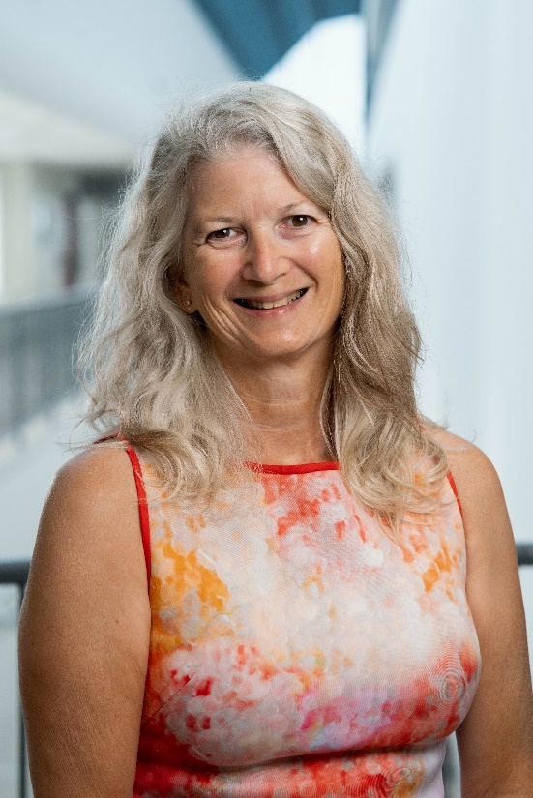
Message from Kate Fyfe
“I am pleased to see our first Diversity, Equity, Inclusion, Social Accountability and Anti-Racism (DEISA-A) Report Card come to fruition. The following pages outline some of our recent key milestones. There are many more initiatives underway and I am grateful for our full team and organizational approach that is powering up our health equity work.
The Timmins and District Hospital DEISA-A Advisory Committee has been exceptional in helping to move health equity learnings and initiatives forward. We are pleased to have a fulsome committee of more than ten TADH staff and ten people from community organizations and/or with lived experience.
Our staff, volunteers and physicians have all been exceptional in working through a health equity lens and approach in our programs and services. It’s a shared responsibility.
Everyone deserves quality health care that is tailored to their needs, regardless of where they live or who they are.
I look forward to continuing to work in partnership to continue this important work.”
-Kate Fyfe, President and CEO, Timmins and District Hospital (TADH)

Slide 3
Introduction
Health equity is woven into the five priorities of the 2022-2027 TADH Strategic Plan, in addition to a stand-alone priority entitled Equity and Social Accountability. These priorities speak to the level of commitment TADH places on health equity. Our five strategic plan priorities are:
To Improve the experience of hospital patients.
To Improve the experience and wellbeing of health providers.
To Improve population health.
To Sustain the financial health of our hospital.
To Focus on equity and social accountability.
To help deliver on these priorities, TADH established a Diversity, Equity, Inclusion, Social Accountability and Anti-Racism (DEISA-A) committee in the spring of 2023. The goal of this committee is to inform and provide feedback to TADH senior leadership on transformational improvements related to equity and social accountability.
Our DEISA-A Committee has two overarching priorities:
Expand the capacity within TADH to support advancing DEISA-A work across the Cochrane District health system to achieve better health outcomes for people.
Work in partnership to reduce health disparities and address DEISA-A for equity seeking population groups across the District to improve patient health care access, experience and outcomes.
This report card tracks our DEISA-A progress and outlines key steps and/or achievements that have taken place on a quarterly basis, based on three indicators:
DEISA-A internal initiatives accomplished or contributed to;
Process improvement accomplishments that enable/support the advancement of health equity;
Work across the system to help reduce disparities in services related to access, experience, and outcomes.

Slide 4
Context and Spotlight
Spotlight
In the late fall of 2023, the Timmins and District Hospital (TADH) Diversity, Equity, Inclusion, Social Accountability and Anti-Racism (DEISA-A) Advisory Committee developed a 2023-2024 Health Equity Work Plan. This plan has 19 Calls to Action and is the foundational work from which our hospital is advancing health equity work. The Committee meets monthly and reports on progress or any delays in initiatives underway.
In early spring 2024, a organizational health equity analysis was completed further to engagement with more than 140 individuals. Fifteen additional calls to action/recommendations have arisen out of this work.
Health equity is advancing at TADH due to a full organizational and team approach. Health equity is not a program or project – it s about creating meaningful outcomes that positively impact the lives of people we serve. We continue to work in partnership and remain open to learning along our health equity journey.

Slide 5
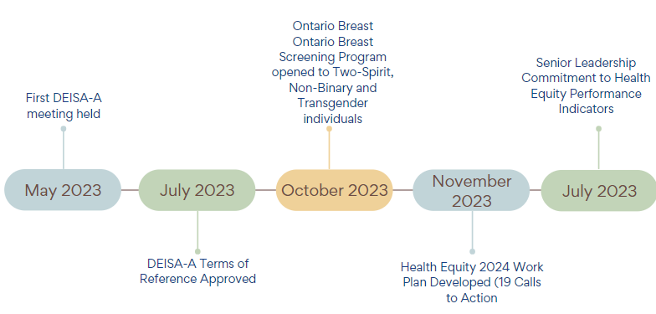
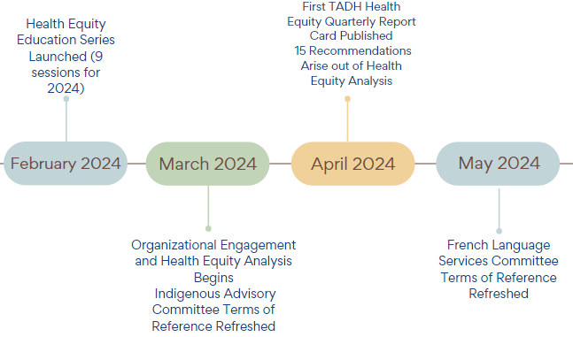
TADH Health Equity Milestone Timeline
Ongoing key initiatives: Advisory Committee Meetings, including: Patient and Family, Indigenous Advisory, French Language Services; Increased Health Equity Communications to TADH Employees and District Partners; DEISA-A Committee membership expansion.

Slide 6
Internal Initiatives
Implemented Seamless MD (a personal digital education and monitoring system) to provide access to mental health supports for patients while they wait on hospital outpatient waitlist to see a therapist.
Created a nicotine replacement therapy program for mental health patients in hospital to support them throughout admission, as part of the cessation of smoking on the hospital premises.
Implemented a designated wound care RN to enhance access to care for vulnerable outpatient populations, complex patients and in-clinic orthopedic patients. More than 500 referrals have been received.
Undertook a health equity strength, gaps, opportunities, threats analysis which led to X recommendations.
Developed a health equity educational learning series available to all TADH employees and District-wide organizations and held three sessions to date.
Held two multi-cultural events to learn about and celebrate new cultures.
Participate in the Rural and Northern Immigration Pilot Program, resulting in 18 new hires (7 RN, 5 RPN, 5 PSW, 1 Social Worker).
Participate in the Ontario immigrant Nominee Program, resulting in three new hires (2 RPN, 1 RN).
Partnered with March of Dimes and received funding to support employee recruitment for people living with disabilities, resulting in one new hire.
Successfully advocated for provincial one-time pressure relief funding for the continuation of clinical care services through the lens of improving health equity in the North, including Timmins and District.
Developed a two page document on Cochrane District Population Health and shared with employees and partners.
Implementation of Health Information System (Meditech Expanse) allows for a digital platform that is inclusive and available for all population groups. Health care practitioners will have up-to-date digital information to make a decision tailored to each patient. Digital capabilities include: collecting and analysing data, coordinating care, promotion of cultural competencies, enhanced health literacy and targeted interventions, to name a few.

Slide 7
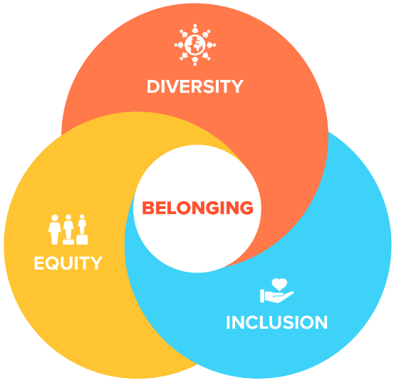
Internal Process Improvements
Implemented a fracture clinic improvement strategy to support access to follow up ED visit appointments for individuals without a home.
New pediatric outpatient clinic has allowed more babies who otherwise would not have easy access to a healthcare professional in a timely fashion to be seen, including families who are often challenged with multiple risk factors for poor health outcomes related to food and shelter security, and increased mental health and addictions issues.
Reviewed TADH Framework for Ethical Decision-Making to embed a health equity approach and process for use.
Reviewed new hire orientation process to embed health equity learning.

Slide 8
System Work
Successfully led ongoing advocacy locally and provincially to support continued operations of the urgent public health needs site, Safe Health Site Timmins, post March 31, 2024 in partnership with Canadian Mental Health Association Cochrane-Timiskaming as it transitions to a Consumption Treatment Services site.
Contributed to completion of the Living Space Relocation Review and the development of the Living Space Relocation Steering Action Plan, both of which are focused on meeting the shelter and service needs of vulnerable populations.
Successfully led (in partnership with OHT partners) a collaborative funding application for a District Palliative Care Coach to support improved access to evidenced-based palliative care and improved patient and family experience.
Successfully advocated for funding dedicated to additional medical imaging (CT) hours to enhance equity and access to medical imaging for the district.
Finalized a foundational report that advocates for a structural base adjustment given the geographical isolation of Timmins and District communities and the existing health inequities of the North.
Meditech Expanse, new WIFI System and Point of Care Technologies in the Laboratory Department are supporting healthcare organizations to effectively reduce disparities and improve the overall health and well-being of communities by allowing for fully accessible digital patient information, anywhere, anytime.

Slide 9
The next TADH Health Equity Report Card will be published August, 2024.
Merci, Mii-gwetch, Thank you
Diversity, Equity, Inclusion, Social Accountability and Anti-Racism Report Card, Q1 2024/25

